Slide 1
FACS results
VHL mutants

Slide 2
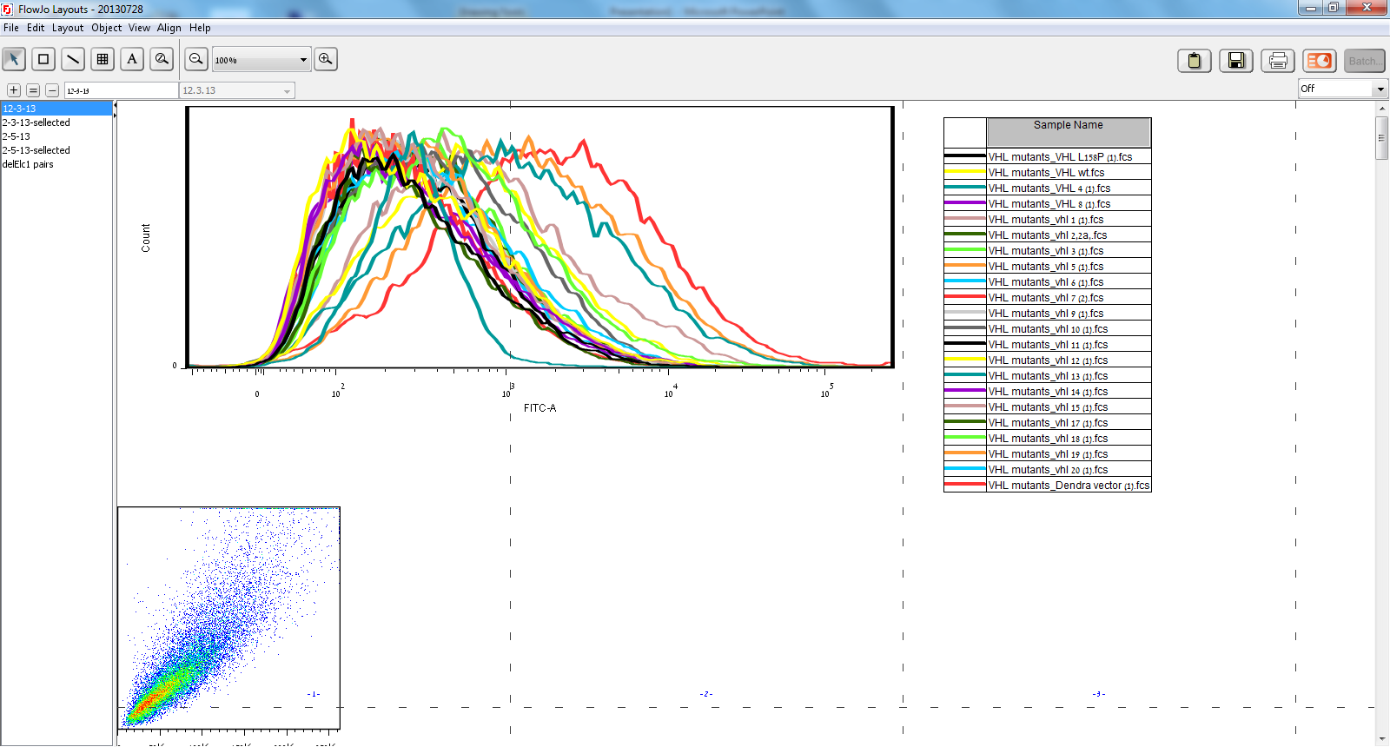
All mutants

Slide 3
statistics

Slide 4
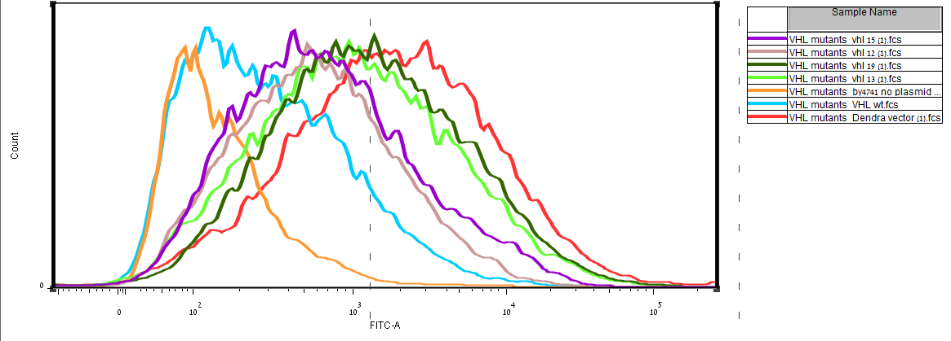
Positive mutants + controls

Slide 5
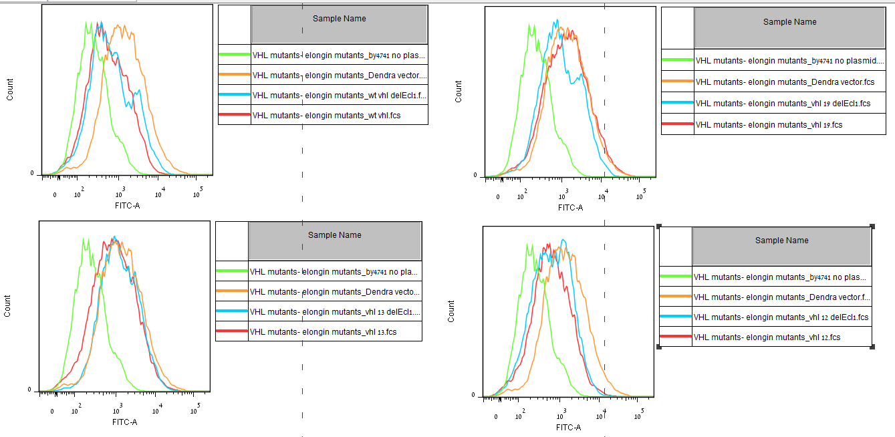
ΔElc1 vrs. WT yeast (no gating)

Slide 6
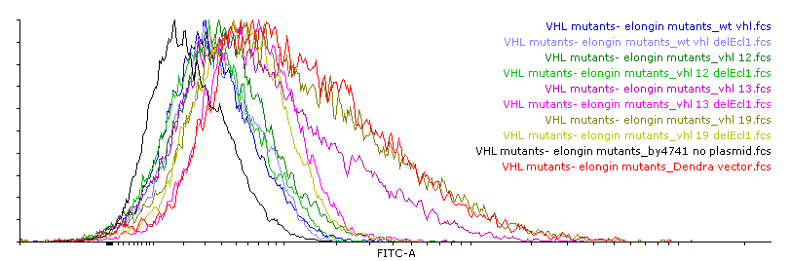
ΔElc1 vrs. WT yeast (no gating)

Slide 7
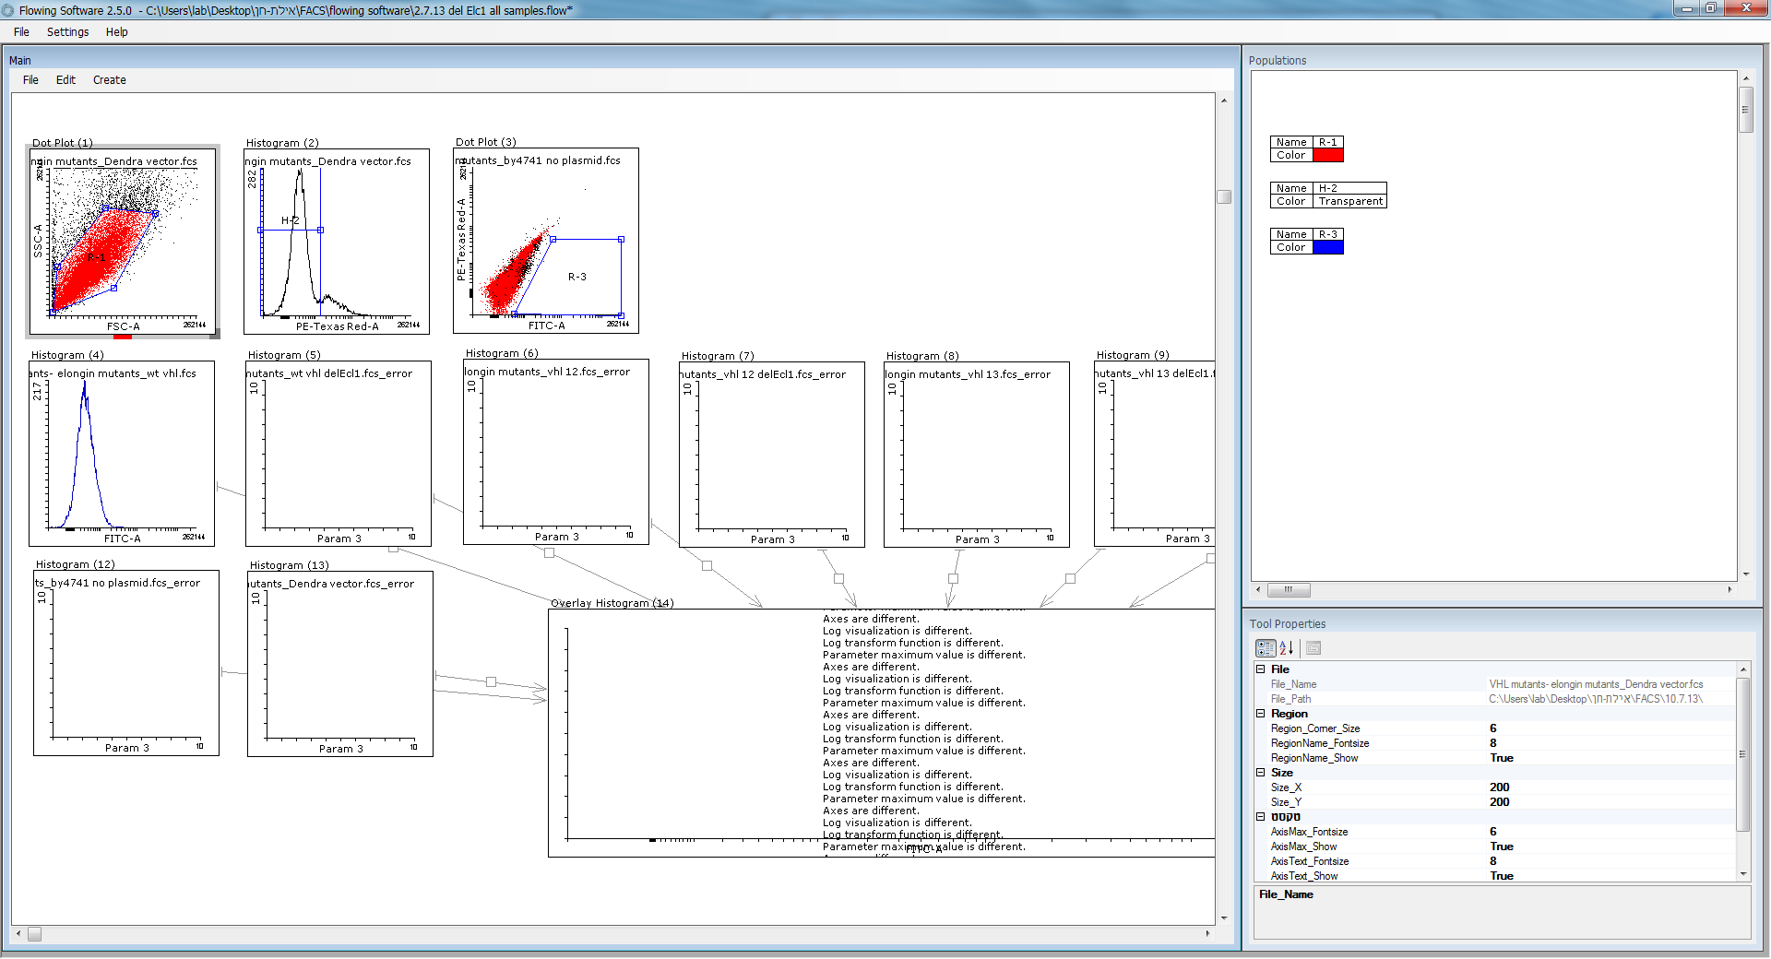
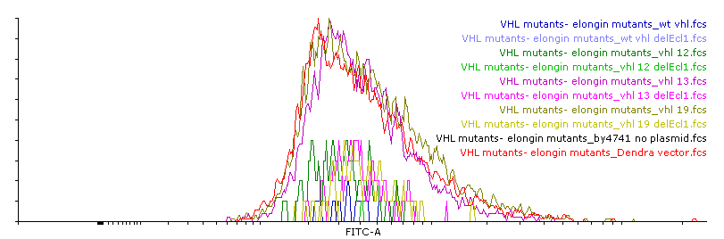
ΔElc1 vrs. WT yeast (with gating)

